Slide 1
NumPy (Numerical Python)
Dr. Sergio Martinez

Slide 2

Research Computing Department
2
Course layout
Introduction
Creating ndarrays
Indexing and slicing
Array manipulation
Math functions
Input/Outputs

Slide 3
Research Computing Department
3
Introduction
NumPy (Numerical Python), is a library consisting of multidimensional array objects and a collection of routines for processing those arrays.
Together with Matplotlib (plotting library), it can be used as a replacement for Matlab.
Using NumPy, a developer can perform:
Mathematical and logical operations on arrays.
Fourier transforms and routines for shape manipulation.
Operations related to linear algebra.
NumPy is open source.
NumPy
Import the package
ndarray object
Data types
Attributes

Slide 4
Research Computing Department
4
Introduction
NumPy is imported using the following syntax:
As a convention, we can import with:
Then, the usage will be:
NumPy
Import the package
ndarray object
Data types
Attributes
import numpy
import numpy as np
np.command(xxx)

Slide 5
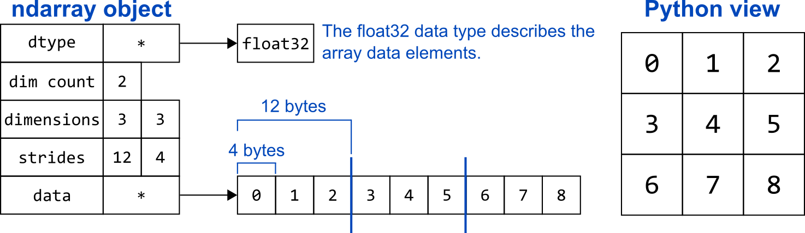
Research Computing Department
5
Introduction
The most important object defined in NumPy is an N-dimensional array type called ndarray.
It describes the collection of items of the same type.
Items in the collection can be accessed using a zero-based index.
NumPy
Import the package
ndarray object
Data types
Attributes

Slide 6
Research Computing Department
6
Introduction
An instance of ndarray class can be constructed by different array creation routines described later
The basic ndarray is created using an array function in NumPy as follows
It creates an ndarray from any object exposing array interface, or from any method that returns an array. The default constructor looks like:
NumPy
Import the package
ndarray object
Data types
Attributes
import numpy as np
A = np.array
A = np.array(object, dtype = None, copy = True, order = None, subok = False, ndmin = 0)

Slide 7
Research Computing Department
7
Introduction
The previous constructor takes the following parameters:
Let’s see some examples:
01_Introduction/ndarray_object_constructor.ipynb
NumPy
Import the package
ndarray object
Data types
Attributes
Sr.No. | Parameter & Description
1 | object Any object exposing the array interface method returns an array, or any (nested) sequence.
2 | dtype Desired data type of array, optional
3 | copy Optional. By default (true), the object is copied
4 | order C (row major) or F (column major) or A (any) (default)
5 | subok By default, returned array forced to be a base class array. If true, sub-classes passed through
6 | ndmin Specifies minimum dimensions of resultant array

Slide 8
Research Computing Department
8
Introduction
NumPy supports a much greater variety of numerical types than Python does. Some of them are:
Those numerical types are instances of dtype (data type) class and they can be used when we create ndarray objects using dtype parameter:
NumPy
Import the package
ndarray object
Data types
Attributes
Sr.No. | Data Types & Description
1 | bool_ Boolean (True or False) stored as a byte
2 | Int8, int16, int32, int64
3 | uint8, uint16, uint32, uint64
4 | float_, float16, float32, float64
5 | complex_, complex64, complex128
# dtype parameter
import numpy as np
a = np.array([1, 2, 3], dtype = np.complex_)
print(a) # [1.+0.j 2.+0.j 3.+0.j]
print(a.dtype) # complex128

Slide 9
Research Computing Department
9
Introduction
Alternatively, we can create custom dtype objects with structured data. We need to provide:
What are the names of the “fields” of the structure, by which they can be accessed.
What is the data-type of each field.
Which part of the memory block each field takes.
Let’s see some examples:
01_Introduction/data_types.ipynb
NumPy
Import the package
ndarray object
Data types
Attributes

Slide 10
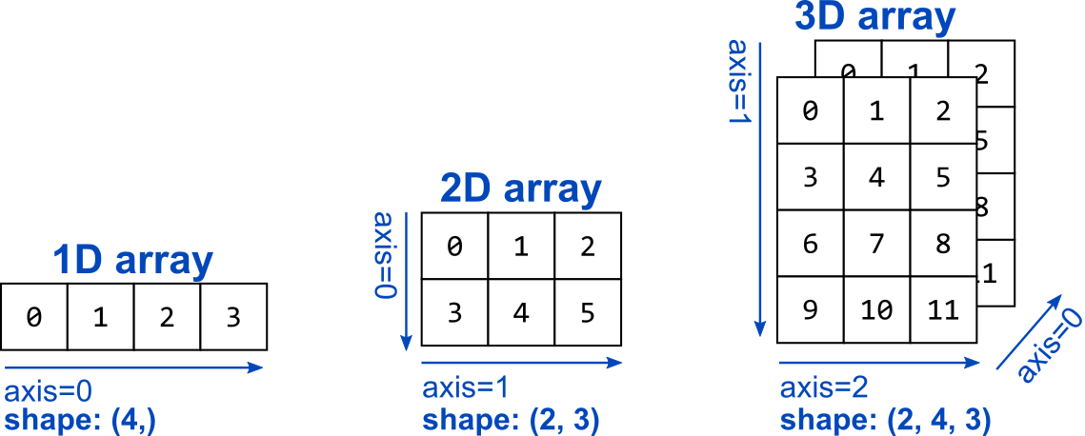
Research Computing Department
10
Introduction
The attribute shape of an array is a tuple indicating the number of elements among each axis. An existing array has this attribute a.shape which contains this tuple. It can be used to reshape an array.
The axes of an array describe the order of indexing into the array, e.g., axis=0 refers to the first index coordinate, axis=1 refers to the second, etc. Pay attention to the axis order convention.
NumPy
Import the package
ndarray object
Data types
Attributes

Slide 11
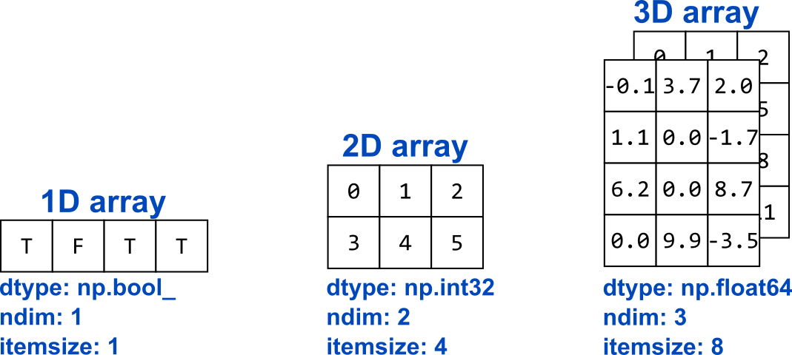
Research Computing Department
11
Introduction
The attribute ndim of an array is a number indicating the number of dimensions of the array.
The attribute itemsize of an array indicates the size of each element in the array in bytes
Let’s see some examples:
01_Introduction/attributes.ipynb
NumPy
Import the package
ndarray object
Data types
Attributes

Slide 12
Research Computing Department
12
Creating ndarrays
A new ndarray object can be constructed by any of the following array creation routines or using a low-level ndarray constructor.
np.array()
np.empty()
np.zeros()
np.ones()
np.asarray()
np.arange()
Array creation
np.empty()
np.zeros()
np.ones()
np.asarray()
np.arrange()

Slide 13
Research Computing Department
13
Creating ndarrays
np.empty creates an uninitialized array of specified shape and dtype. It uses the following constructor
Array creation
np.empty()
np.zeros()
np.ones()
np.asarray()
np.arrange()
np.empty(shape, dtype = float, order = 'C')
Sr.No. | Parameter & Description
1 | shape Shape of an empty array in int or tuple of int
2 | dtype By default, the data type of input data is applied to the resultant ndarray
3 | order C (row major) or F (column major). C is default

Slide 14
Research Computing Department
14
Creating ndarrays
np.zeros returns a new array of specified size, filled with zeros.
Array creation
np.empty()
np.zeros()
np.ones()
np.asarray()
np.arrange()
np.zeros(shape, dtype = float, order = 'C')
Sr.No. | Parameter & Description
1 | shape Shape of an empty array in int or tuple of int
2 | dtype By default, the data type of input data is applied to the resultant ndarray
3 | order C (row major) or F (column major). C is default

Slide 15
Research Computing Department
15
Creating ndarrays
np.ones returns a new array of specified size, filled with ones.
Array creation
np.empty()
np.zeros()
np.ones()
np.asarray()
np.arrange()
np.ones(shape, dtype = float, order = 'C')
Sr.No. | Parameter & Description
1 | shape Shape of an empty array in int or tuple of int
2 | dtype By default, the data type of input data is applied to the resultant ndarray
3 | order C (row major) or F (column major). C is default

Slide 16
Research Computing Department
16
Creating ndarrays
np.asarray This function is similar to np.array except for the fact that it has fewer parameters. This routine is useful for converting Python sequence into ndarray.
Array creation
np.empty()
np.zeros()
np.ones()
np.asarray()
np.arrange()
np.asarray(a, dtype = float, order = 'C')
Sr.No. | Parameter & Description
1 | a Input data in any form such as list, list of tuples, tuples, tuple of tuples or tuple of lists
2 | dtype By default, the data type of input data is applied to the resultant ndarray
3 | order C (row major) or F (column major). C is default

Slide 17
Research Computing Department
17
Creating ndarrays
np.arange returns an ndarray object containing evenly spaced values within a given range. The format of the function is as follows:
Array creation
np.empty()
np.zeros()
np.ones()
np.asarray()
np.arrange()
np.arange(start, stop, step, dtype)
Sr.No. | Parameter & Description
1 | start The start of an interval. If omitted, defaults to 0
2 | stop The end of an interval (not including this number)
3 | step Spacing between values, default is 1
4 | dtype Data type of resulting ndarray. If not given, data type of input is used
Let’s see some examples:
02_Creating_ndarrays/ndarray_creation.ipynb

Slide 18
Research Computing Department
18
Indexing and slicing
New ndarray objects can also be created from another ndarray previously created. Creating a new ndarray by this way can be done as a copy or as a view of the existing one (or part of it when we use indexing and slicing).
The main difference between a copy and a view of an array is that the copy is a new array, and the view is just a view of the original array (basically a pointer).
The copy owns the data and any changes made to the copy will not affect original array, and any changes made to the original array will not affect the copy.
The view does not own the data and any changes made to the view will affect the original array, and any changes made to the original array will affect the view.
Copies and views
1D array
2D array
3D array
Iterating over array
Broadcasting

Slide 19
Research Computing Department
19
Indexing and slicing
By default, assigning one ndarray to another will create a view.
Copies and views
1D array
2D array
3D array
Iterating over array
Broadcasting
import numpy as np
a = np.arange(10)
b = a
print(a)
print(b)
# a and b are the same object
print(id(a))
print(id(b))
# Making changes in b will also change a and viceversa
b[5] = 100
print(a)
print(b)

Slide 20
Research Computing Department
20
Indexing and slicing
A copy of the original ndarray can be done with the assignation using the function np.copy().
Copies and views
1D array
2D array
3D array
Iterating over array
Broadcasting
import numpy as np
a = np.arange(10)
b = a.copy()
print(a)
print(b)
# a and b are different objects
print(id(a))
print(id(b))
# Making changes in b will not affect a
b[5] = 100
print(a)
print(b)

Slide 21
Research Computing Department
21
Indexing and slicing
A view of the original ndarray can also be done explicitely with the assignation using the function np.view().
Copies and views
1D array
2D array
3D array
Iterating over array
Broadcasting
import numpy as np
a = np.arange(10)
b = a.view()
print(a)
print(b)
# a and b are the same object
print(id(a))
print(id(b))
# Making changes in b will also change a and viceversa
b[5] = 100
print(a)
print(b)
Let’s see some examples:
03_Indexing_and_slicing/copies_and_views.ipynb

Slide 22
Research Computing Department
22
Indexing and slicing
The same approaches can be used when indexing or slicing ndarray objects.
When the elements can be addressed with offsets, strides, and counts in the original array, the result will be given as a view:
When we use advanced indexing, the result will be given as a copy:
Copies and views
1D array
2D array
3D array
Iterating over array
Broadcasting
import numpy as np
a = np.arange(10)
b = a[2:6] # b is a view of a
import numpy as np
a = np.arange(10)
b = a[[1,7]] # b is a copy of a elements

Slide 23
Research Computing Department
23
Indexing and slicing
Indexing one element (view)
Copies and views
1D array
2D array
3D array
Iterating over array
Broadcasting

Slide 24
Research Computing Department
24
Indexing and slicing
Slicing consecutive elements I (view)
Copies and views
1D array
2D array
3D array
Iterating over array
Broadcasting

Slide 25
Research Computing Department
25
Indexing and slicing
Slicing consecutive elements II (view)
Copies and views
1D array
2D array
3D array
Iterating over array
Broadcasting

Slide 26
Research Computing Department
26
Indexing and slicing
Slicing with range (view)
Copies and views
1D array
2D array
3D array
Iterating over array
Broadcasting

Slide 27
Research Computing Department
27
Indexing and slicing
Slicing with range and stride I (view)
Copies and views
1D array
2D array
3D array
Iterating over array
Broadcasting

Slide 28
Research Computing Department
28
Indexing and slicing
Slicing with range and stride II (view)
Copies and views
1D array
2D array
3D array
Iterating over array
Broadcasting

Slide 29
Research Computing Department
29
Indexing and slicing
Advanced indexing (copy)
Copies and views
1D array
2D array
3D array
Iterating over array
Broadcasting

Slide 30
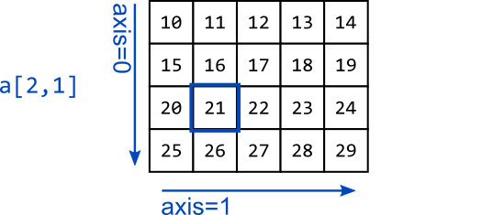
Research Computing Department
30
Indexing and slicing
Indexing one element (view)
Copies and views
1D array
2D array
3D array
Iterating over array
Broadcasting

Slide 31
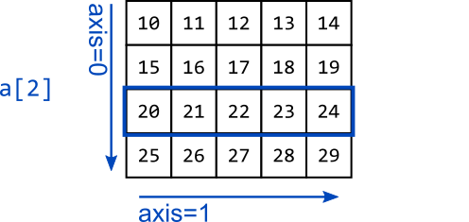
Research Computing Department
31
Indexing and slicing
Slicing entire row (view)
Copies and views
1D array
2D array
3D array
Iterating over array
Broadcasting

Slide 32
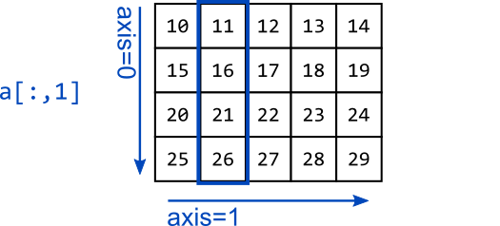
Research Computing Department
32
Indexing and slicing
Slicing entire column (view)
Copies and views
1D array
2D array
3D array
Iterating over array
Broadcasting

Slide 33
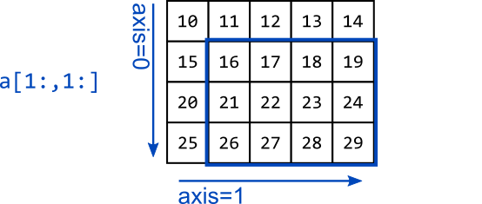
Research Computing Department
33
Indexing and slicing
Slicing sub-matrix (view)
Copies and views
1D array
2D array
3D array
Iterating over array
Broadcasting

Slide 34
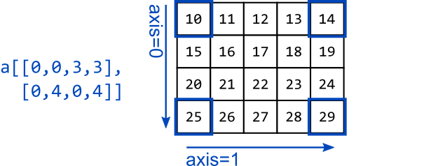
Research Computing Department
34
Indexing and slicing
Advanced indexing (copy)
Copies and views
1D array
2D array
3D array
Iterating over array
Broadcasting

Slide 35
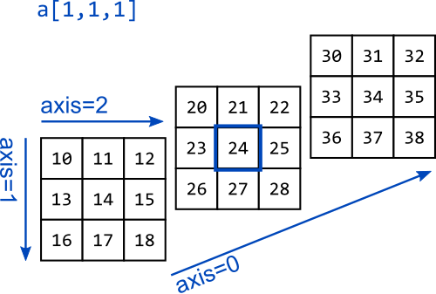
Research Computing Department
35
Indexing and slicing
Indexing one element (view)
Copies and views
1D array
2D array
3D array
Iterating over array
Broadcasting

Slide 36
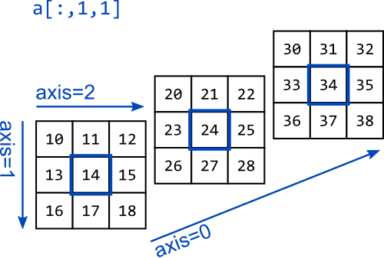
Research Computing Department
36
Indexing and slicing
Slicing 1D array I (view)
Copies and views
1D array
2D array
3D array
Iterating over array
Broadcasting

Slide 37
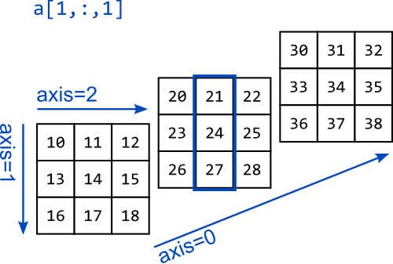
Research Computing Department
37
Indexing and slicing
Slicing 1D array II (view)
Copies and views
1D array
2D array
3D array
Iterating over array
Broadcasting

Slide 38

Research Computing Department
38
Indexing and slicing
Slicing 1D array III (view)
Copies and views
1D array
2D array
3D array
Iterating over array
Broadcasting

Slide 39

Research Computing Department
39
Indexing and slicing
Slicing 2D array I (view)
Copies and views
1D array
2D array
3D array
Iterating over array
Broadcasting

Slide 40
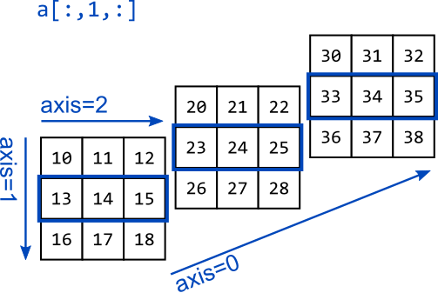
Research Computing Department
40
Indexing and slicing
Slicing 2D array II (view)
Copies and views
1D array
2D array
3D array
Iterating over array
Broadcasting

Slide 41
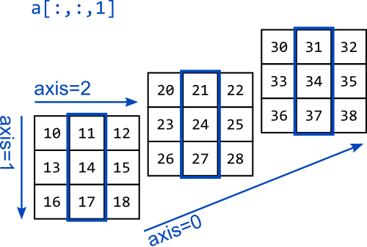
Research Computing Department
41
Indexing and slicing
Slicing 2D array III (view)
Copies and views
1D array
2D array
3D array
Iterating over array
Broadcasting

Slide 42
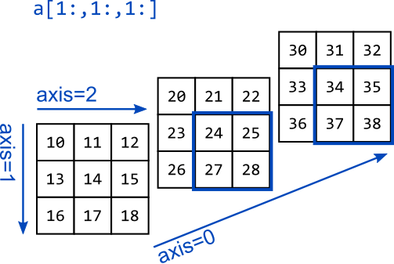
Research Computing Department
42
Indexing and slicing
Slicing 3D array I (view)
Copies and views
1D array
2D array
3D array
Iterating over array
Broadcasting

Slide 43
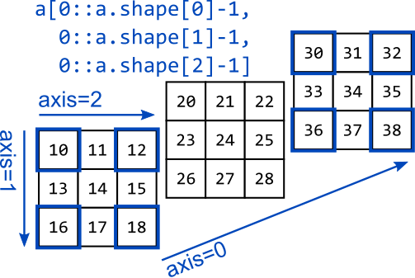
Research Computing Department
43
Indexing and slicing
Slicing 3D array II (view)
Copies and views
1D array
2D array
3D array
Iterating over array
Broadcasting
Let’s see some examples:
03_Indexing_an_slicing/indexing_and_slicing.ipynb

Slide 44
Research Computing Department
44
Indexing and slicing
Iterating means going through elements one by one.
As we deal with multi-dimensional arrays in numpy, we can do this using basic for loop of python.
In basic for loops, iterating through each scalar of an ndarray we need to use n for loops which can be difficult to write for arrays with very high dimensionality. For example:
Copies and views
1D array
2D array
3D array
Iterating over array
Broadcasting
import numpy as np
a = np.array([[[1, 2, 3], [4, 5, 6]], [[7, 8, 9], [10, 11, 12]]])
for x in a:
for y in x:
for z in y:
print(z)

Slide 45
Research Computing Department
45
Indexing and slicing
The iterator object nditer provides many flexible ways to visit all the elements of one or more arrays in a systematic fashion.
Copies and views
1D array
2D array
3D array
Iterating over array
Broadcasting
import numpy as np
a = np.array([[[1, 2, 3], [4, 5, 6]],
[[7, 8, 9], [10, 11, 12]]])
for x in np.nditer(a):
print(x)
Let’s see some examples:
03_Indexing_and_slicing/iterating_over_array.ipynb

Slide 46
Research Computing Department
46
Indexing and slicing
numpy operations are usually done element-by-element which requires two arrays to have exactly the same shape.
The term broadcasting describes how numpy treats arrays with different shapes during arithmetic operations. Subject to certain constraints, the smaller array is “broadcast” across the larger array so that they have compatible shapes.
Copies and views
1D array
2D array
3D array
Iterating over array
Broadcasting
import numpy as np
a = np.array([1.0, 2.0, 3.0])
b = np.array([2.0, 2.0, 2.0])
c = a * b
print(c) # [2. 4. 6.]
import numpy as np
a = np.array([1.0, 2.0, 3.0])
b = 2.0
c = a * b
print(c) # [2. 4. 6.]

Slide 47
Research Computing Department
47
Indexing and slicing
Broadcasting rules:
If arrays have different number of dimensions, insert new axis on the left until arrays have the same number of dimensions.
For each axis i, if arrays dimension[i] do not match, “stretch” the arrays where dimension[i] = 1 to match other arrays.
If no match and dimension[i] != 1, then there will be an error.
Copies and views
1D array
2D array
3D array
Iterating over array
Broadcasting
ValueError: operands could not be broadcast together with shapes …

Slide 48
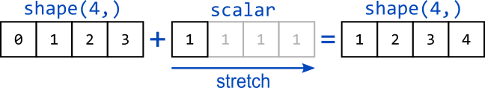
Research Computing Department
48
Indexing and slicing
Broadcasting - 1D array and scalar:
Copies and views
1D array
2D array
3D array
Iterating over array
Broadcasting

Slide 49
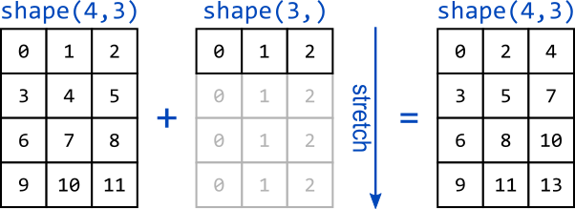
Research Computing Department
49
Indexing and slicing
Broadcasting - 2D array and 1D array I:
Copies and views
1D array
2D array
3D array
Iterating over array
Broadcasting

Slide 50
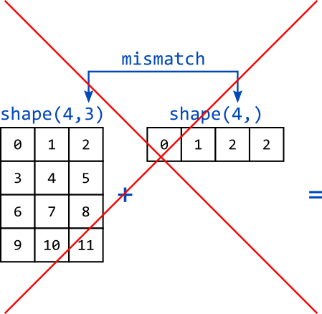
Research Computing Department
50
Indexing and slicing
Broadcasting - 2D array and 1D array II:
Copies and views
1D array
2D array
3D array
Iterating over array
Broadcasting

Slide 51
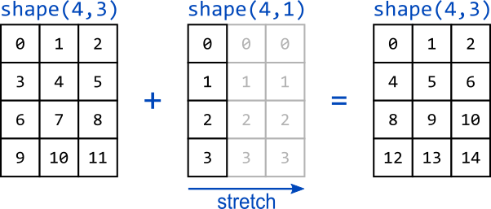
Research Computing Department
51
Indexing and slicing
Broadcasting - 2D array and 2D array I:
Copies and views
1D array
2D array
3D array
Iterating over array
Broadcasting

Slide 52
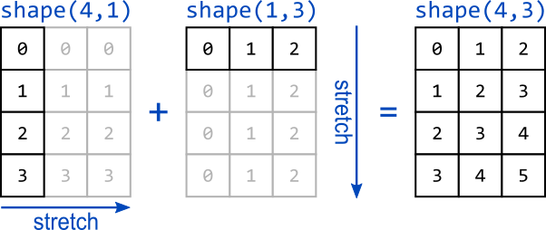
Research Computing Department
52
Indexing and slicing
Broadcasting - 2D array and 2D array II:
Copies and views
1D array
2D array
3D array
Iterating over array
Broadcasting

Slide 53
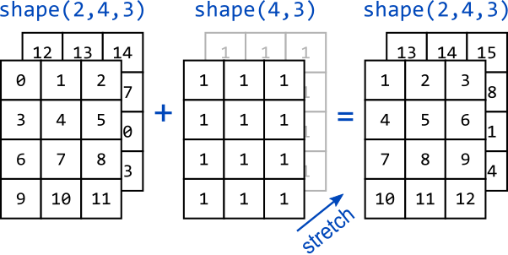
Research Computing Department
53
Indexing and slicing
Broadcasting - 3D array and 2D array:
Copies and views
1D array
2D array
3D array
Iterating over array
Broadcasting
Let’s see some examples:
03_Indexing_and_slicing/broadcasting.ipynb

Slide 54
Research Computing Department
54
Array manipulation
Changing shape
Transpose
Change dimensions
Joining arrays
Splitting arrays
Adding/Removing elements
Sr.No. | Function & Description
1 | reshape Gives a new shape to an array without changing its data.
2 | flat A 1-D iterator over the array
3 | flatten Returns a copy of the array collapsed into one dimension
4 | ravel Returns a contiguous flattened array

Slide 55
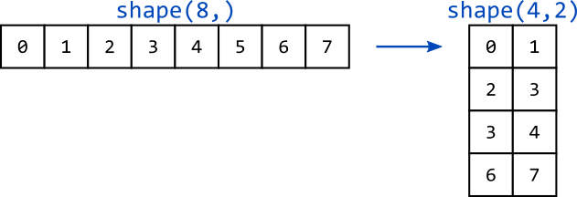
Research Computing Department
55
Array manipulation
Reshape 1D array into 2D array (view):
Changing shape
Transpose
Change dimensions
Joining arrays
Splitting arrays
Adding/Removing elements

Slide 56
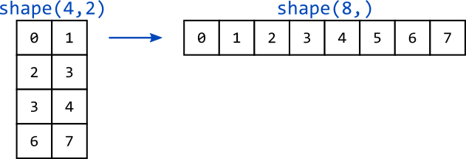
Research Computing Department
56
Array manipulation
Flatten 2D array (copy):
Changing shape
Transpose
Change dimensions
Joining arrays
Splitting arrays
Adding/Removing elements

Slide 57
Research Computing Department
57
Array manipulation
Ravel 2D array (view):
Changing shape
Transpose
Change dimensions
Joining arrays
Splitting arrays
Adding/Removing elements
Let’s see some examples:
04_Array_manipulation/changing_shape.ipynb

Slide 58
Research Computing Department
58
Array manipulation
Changing shape
Transpose
Change dimensions
Joining arrays
Splitting arrays
Adding/Removing elements
Sr.No. | Function & Description
1 | transpose Permutes the dimensions of an array
2 | T Same as self.transpose()
3 | rollaxis Rolls the specified axis backwards
4 | swapaxes Interchanges the two axes of an array

Slide 59
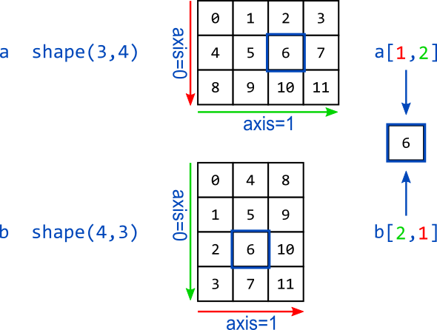
Research Computing Department
59
Array manipulation
Transpose of 2D array I (view):
Changing shape
Transpose
Change dimensions
Joining arrays
Splitting arrays
Adding/Removing elements

Slide 60
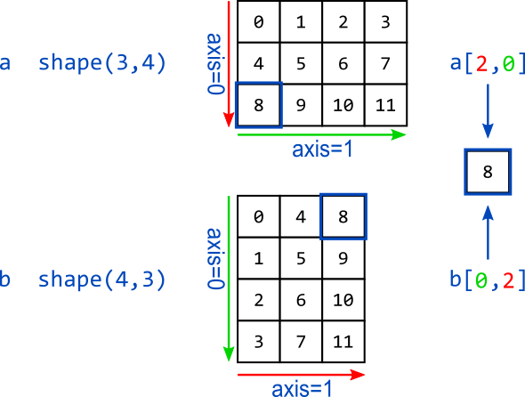
Research Computing Department
60
Array manipulation
Transpose of 2D array II (view):
Changing shape
Transpose
Change dimensions
Joining arrays
Splitting arrays
Adding/Removing elements

Slide 61
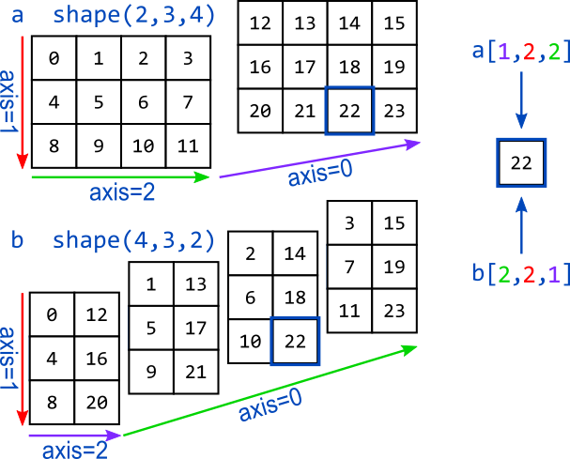
Research Computing Department
61
Array manipulation
Transpose of 3D array (view):
Changing shape
Transpose
Change dimensions
Joining arrays
Splitting arrays
Adding/Removing elements

Slide 62
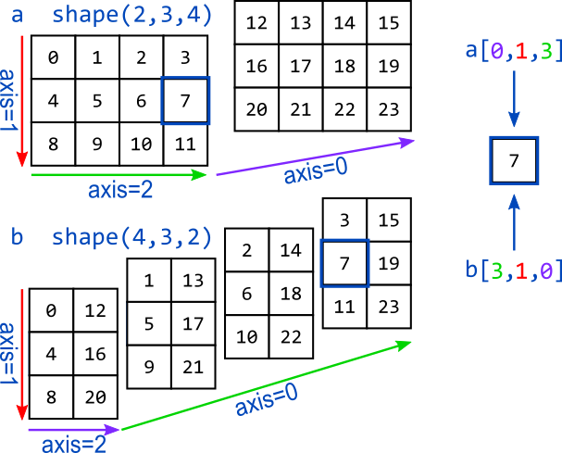
Research Computing Department
62
Array manipulation
Transpose of 3D array (view):
Changing shape
Transpose
Change dimensions
Joining arrays
Splitting arrays
Adding/Removing elements
Let’s see some examples:
04_Array_manipulation/transpose.ipynb

Slide 63
Research Computing Department
63
Array manipulation
Changing shape
Transpose
Change dimensions
Joining arrays
Splitting arrays
Adding/Removing elements
Sr.No. | Function & Description
1 | broadcast Produces an object that mimics broadcasting
2 | broadcast_to Broadcasts an array to a new shape
3 | expand_dims Expands the shape of an array
4 | squeeze Removes single-dimensional entries from the shape of an array
Let’s see some examples:
04_Array_manipulation/changing_dimensions.ipynb

Slide 64
Research Computing Department
64
Array manipulation
Changing shape
Transpose
Change dimensions
Joining arrays
Splitting arrays
Adding/Removing elements
Sr.No. | Function & Description
1 | concatenate Joins a sequence of arrays along an existing axis
2 | stack Joins a sequence of arrays along a new axis
3 | hstack Stacks arrays in sequence horizontally (column wise)
4 | vstack Stacks arrays in sequence vertically (row wise)
Let’s see some examples:
04_Array_manipulation/joining_arrays.ipynb

Slide 65
Research Computing Department
65
Array manipulation
Changing shape
Transpose
Change dimensions
Joining arrays
Splitting arrays
Adding/Removing elements
Sr.No. | Function & Description
1 | split Splits an array into multiple sub-arrays
2 | hsplit Splits an array into multiple sub-arrays horizontally (column-wise)
3 | vsplit Splits an array into multiple sub-arrays vertically (row-wise)
Let’s see some examples:
04_Array_manipulation/splitting_arrays.ipynb

Slide 66
Research Computing Department
66
Array manipulation
Changing shape
Transpose
Change dimensions
Joining arrays
Splitting arrays
Adding/Removing elements
Sr.No. | Function & Description
1 | resize Returns a new array with the specified shape
2 | append Appends the values to the end of an array
3 | insert Inserts the values along the given axis before the given indices
4 | delete Returns a new array with sub-arrays along an axis deleted
5 | unique Finds the unique elements of an array
Let’s see some examples:
04_Array_manipulation/adding_removing.ipynb

Slide 67
Research Computing Department
67
Math functions
Rounding functions
Arithmetical functions
Statistical functions
Linear algebra
Sr.No. | Function & Description
1 | around Returns the value rounded to the desired precision.
2 | floor This function returns the largest integer not greater than the input parameter.
3 | ceil This function returns the smallest integer greater than the input parameter.
Let’s see some examples:
05_Math_functions/rounding_functions.ipynb

Slide 68
Research Computing Department
68
Math functions
Rounding functions
Arithmetical functions
Statistical functions
Linear algebra
Sr.No. | Function & Description
1 | add Adds arguments element-wise.
2 | substract Substracts arguments element-wise.
3 | multiply Multiplies arguments element-wise.
4 | divide Divides arguments element-wise.
5 | power First array elements raised to powers from second array, element-wise.
6 | mod Return element-wise remainder of division.
Let’s see some examples:
05_Math_functions/arithmetical_functions.ipynb

Slide 69
Research Computing Department
69
Math functions
Rounding functions
Arithmetical functions
Statistical functions
Linear algebra
Sr.No. | Function & Description
1 | amax Returns the maximum of an array or maximum along an axis.
2 | amin Returns the minimum of an array or minimum along an axis.
3 | sum Sum of array elements over a given axis.
4 | mean Returns the arithmetic mean of elements in the array.
5 | average Computes the weighted average of elements in an array according to their respective weight given in another array.
Let’s see some examples:
05_Math_functions/statistical_functions.ipynb

Slide 70
Research Computing Department
70
Math functions
Rounding functions
Arithmetical functions
Statistical functions
Linear algebra
Sr.No. | Function & Description
1 | dot Dot product of two arrays.
2 | matmul Matrix multiplication.
3 | determinant Computes the determinant of the array.
4 | inv Finds the inverse of a matrix.
Let’s see some examples:
05_Math_functions/linear_algebra.ipynb

Slide 71
Research Computing Department
71
Input/output
ndarray objects can be saved to and loaded from the disk files.
NumPy introduces a simple file format for ndarray objects. This .npy file stores data, shape, dtype and other information required to reconstruct the ndarray in a disk file.
Save / Load
Savez / Load
Load image
import numpy as np
a = np.array([1,2,3,4,5]) np.save('outfile',a)
b = np.load('outfile.npy')
print(b) # array([1, 2, 3, 4, 5])

Slide 72
Research Computing Department
72
Input/output
It is possible to save multiple ndarray objects in the same file .npz using the finction savez().
Save / Load
Savez / Load
Load image
import numpy as np
a = np.array([1,2,3,4,5])
b = np.arange(12).reshape(3,4)
c = np.arange(24).reshape(2,3,4)
np.savez('workspace', a_name=a, b_name=b, c_name=c)
npz_file = np.load('workspace.npz') print(npz_file.files, '\n')
print('a = ', npz_file['a_name'], '\n')
print('b = ', npz_file['b_name'], '\n')
print('c = ', npz_file['c_name'], '\n')
Let’s see some examples:
06_Input_output/save_load.ipynb

Slide 73
Research Computing Department
73
Input/output
This is one example of how to import an image from disk into a numpy object using skimage package.
Generally, an image will be a 3D array where one of the dimensions will have the value of 3, corresponding to the values of the light in the red, green and blue wavelengths (RGB).
Save / Load
Savez / Load
Load image
from skimage import io
im= io.imread("lena_color.jpg")
print(type(im)) # <class 'numpy.ndarray'>
print(im.dtype) # uint8
print(im.shape) # (512, 512, 3)
Let’s see some examples:
06_Input_output/load_image.ipynb

